Slide 1
Predicting growth conditions from mRNA and protein abundances
Umut Caglar UT Austin (Wilke Lab)

Slide 2
Can we predict bacterial growth conditions from mRNA and protein abundances by machine learning?

Slide 3
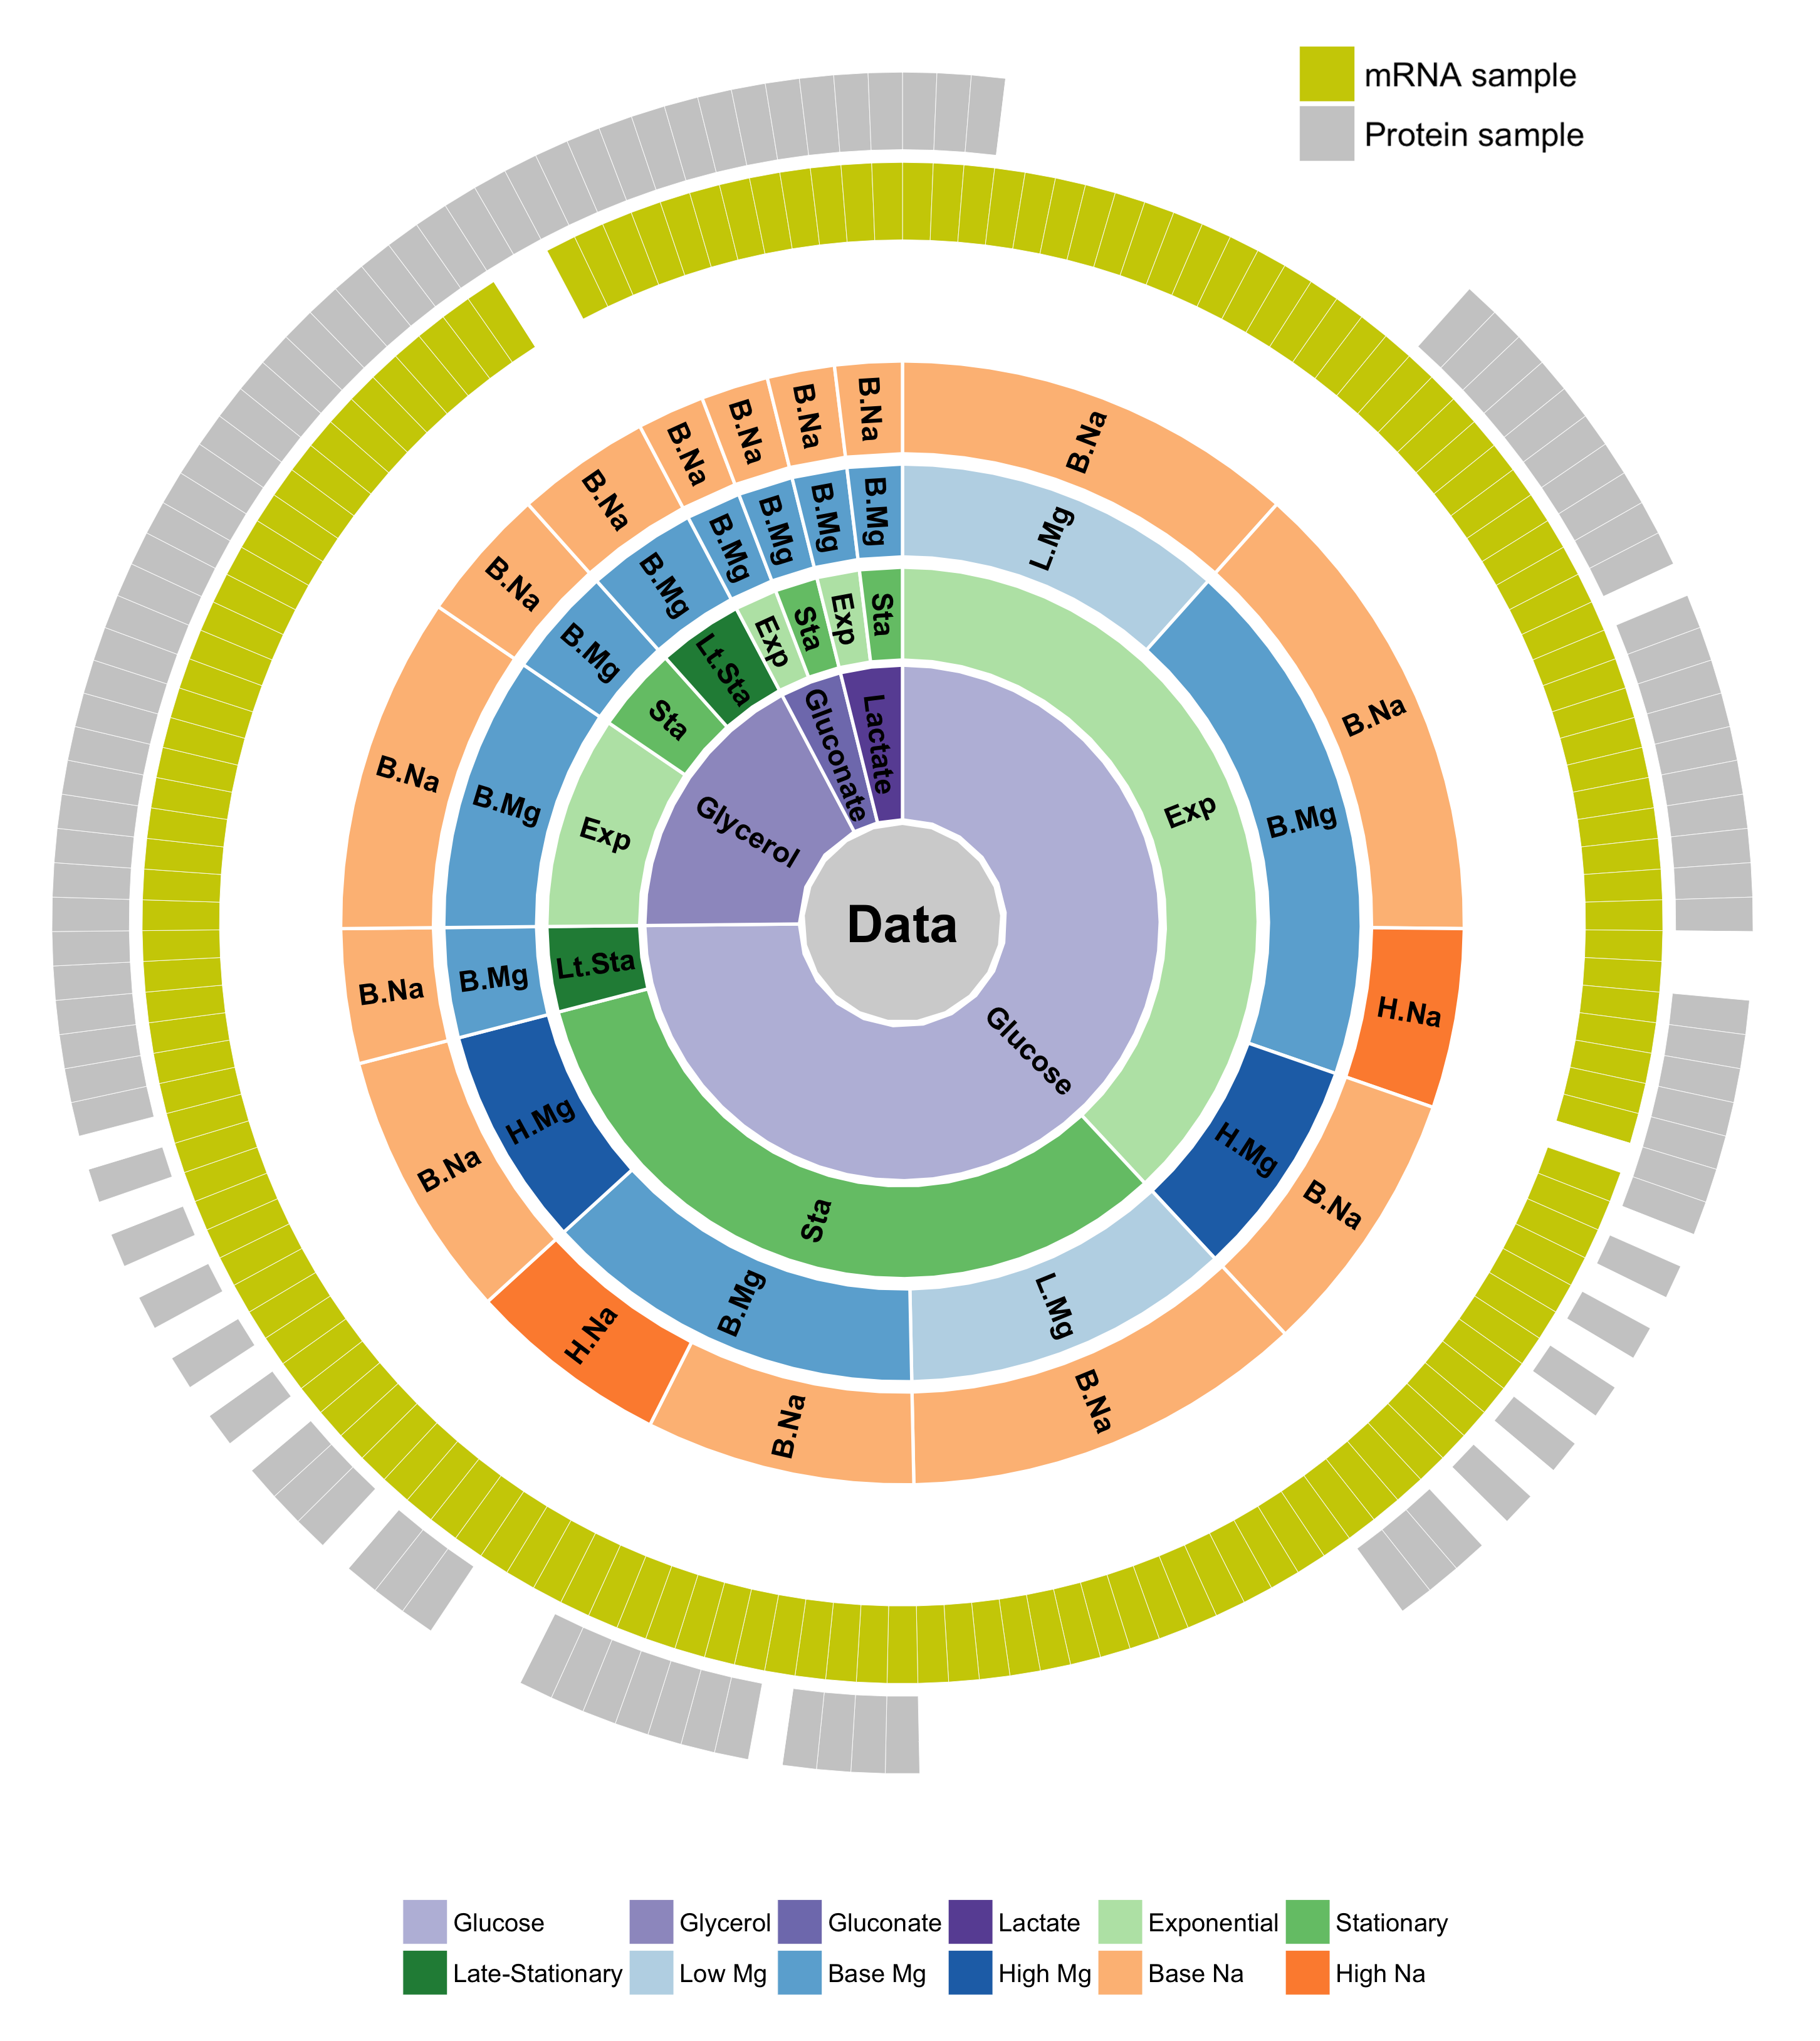
We have a large data set to apply to this problem

Slide 4
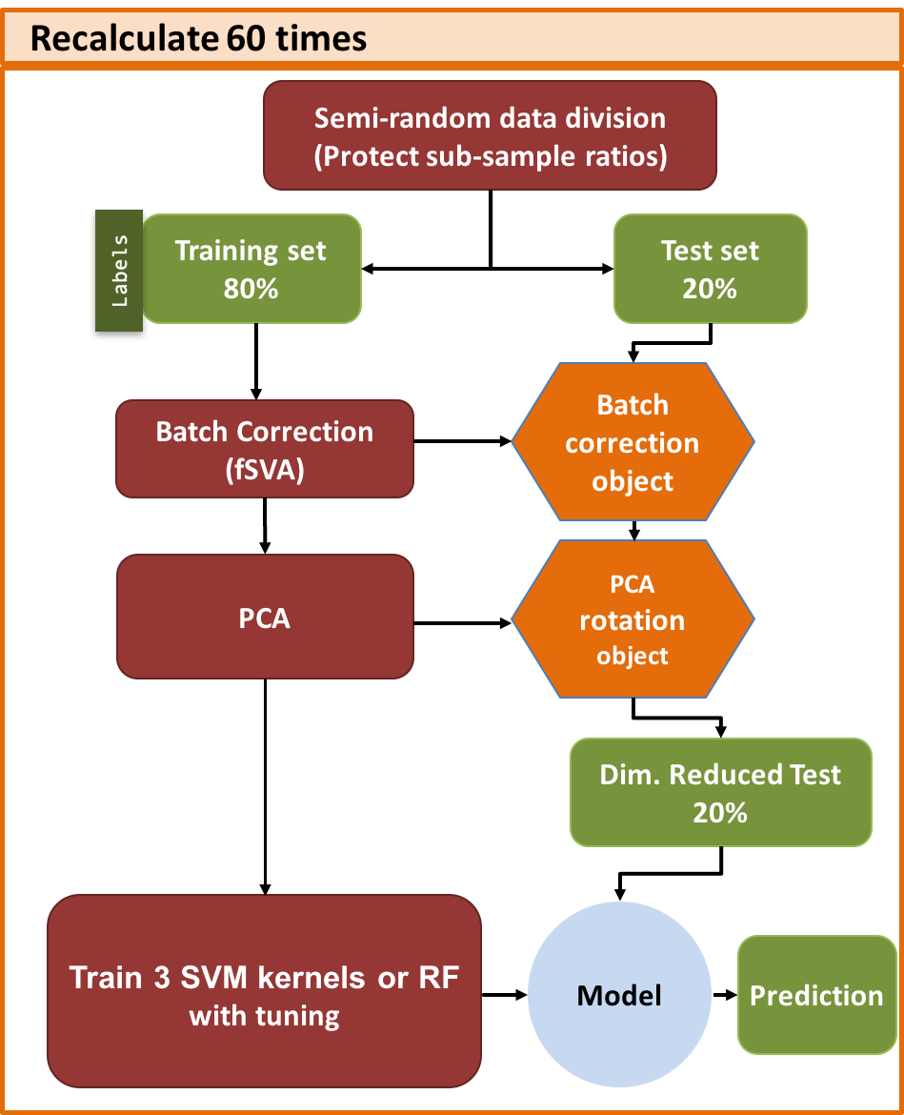
INITIAL DATA PREPERATION
DeSeq2, log transform.
SAMPLES
Labels
SVM Training with Tuning
Training set 80%
Labels
Semi-random data division
(Protect sub-sample ratios)
Training set 60%
Tune set 20%
Labels
3 SVM kernels or RF
Class weight normalization
Model
Parameter dependent prediction
Best
Model

Slide 5
INITIAL DATA PREPERATION
DeSeq2, log transform.
SAMPLES
Labels
SVM Training with Tuning
Training set 80%
Labels
Semi-random data division
(Protect sub-sample ratios)
Training set 60%
Tune set 20%
Labels
3 SVM kernels or RF
Class weight normalization
Model
Parameter dependent prediction
Best
Model

Slide 6
INITIAL DATA PREPERATION
DeSeq2, log transform.
SAMPLES
Labels
SVM Training with Tuning
Training set 80%
Labels
Semi-random data division
(Protect sub-sample ratios)
Training set 60%
Tune set 20%
Labels
3 SVM kernels or RF
Class weight normalization
Model
Parameter dependent prediction
Best
Model

Slide 7
Model predictions are summarized as confusion matrix
Pred True | A | B | C
A | 15 | 7 | 2
B | 11 | 45 | 1
C | 9 | 3 | 33
Confusion Matrix

Slide 8
Model predictions are summarized as confusion matrix
Pred True | A | B | C
A | 15 | 7 | 2
B | 11 | 45 | 1
C | 9 | 3 | 33
Confusion Matrix

Slide 9
Model predictions are summarized as confusion matrix
Pred True | A | B | C
A | 15 | 7 | 2
B | 11 | 45 | 1
C | 9 | 3 | 33
TP
FN
FP
Confusion Matrix

Slide 10
SVM with radial kernel is the winner for mRNA predictions

Slide 11
SVM with sigmoidal kernel is the winner for protein predictions

Slide 12
What percent of the row “A” is on diagonal ?
Precision = TP / (TP + FP)
Pred True | A | B | C
A | 15 | 7 | 2
B | 11 | 45 | 1
C | 9 | 3 | 33
TP
FN
FP
Confusion Matrix

Slide 13
What percent of the column “A” is on diagonal ?
Recall = TP / (TP + FN)
Pred True | A | B | C
A | 15 | 7 | 2
B | 11 | 45 | 1
C | 9 | 3 | 33
TP
FN
FP
Confusion Matrix

Slide 14
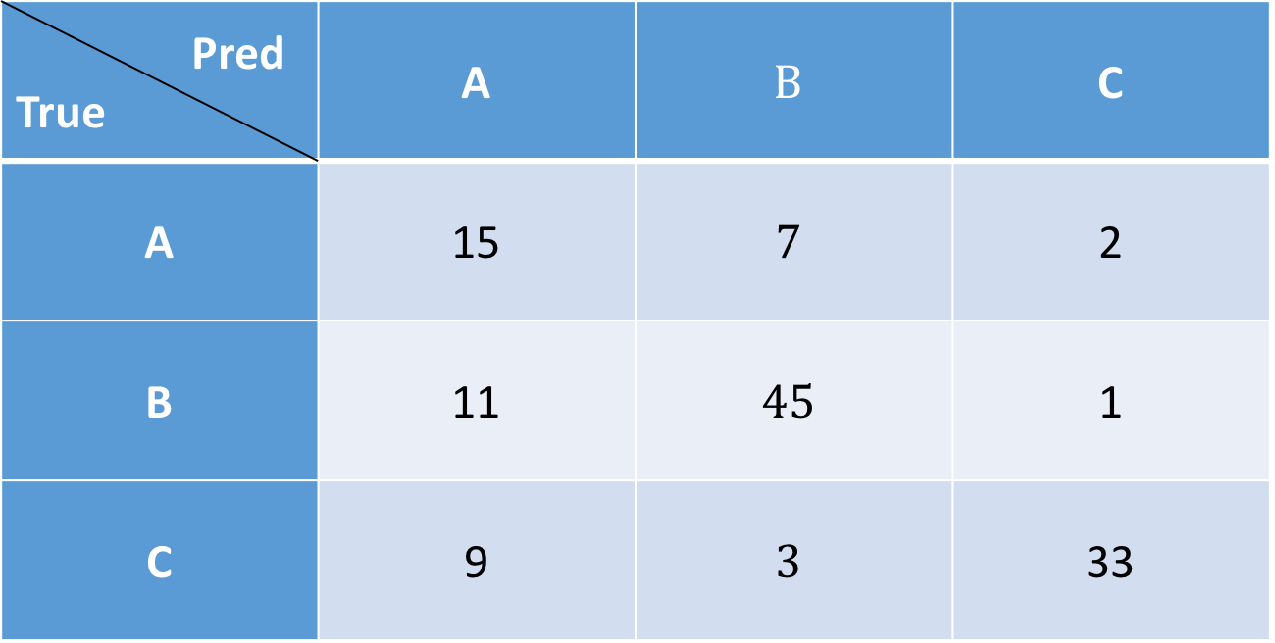

By using precision and recall we can define a metric; called F Score; weighted harmonic mean of precision and recall.
F score = $\frac{2}{\frac{1}{precision} + 1/(recall ∗ β)}$
Pred True | A | $$B$$ | C
A | 15 | $$7$$ | 2
B | 11 | $$45$$ | 1
C | 9 | $$3$$ | 33
TP
FN
FP
Confusion Matrix

Slide 15

By using precision and recall we can define a metric; called F Score; weighted harmonic mean of precision and recall.
F1 score = $\frac{2}{\frac{1}{precision} + 1/(recall ∗1)} \text{=} \frac{2 Tp}{2 Tp + Fp + Fn}$
Pred True | A | B | C
A | 15 | 7 | 2
B | 11 | 45 | 1
C | 9 | 3 | 33
TP
FN
FP
Confusion Matrix

Slide 16

Macro F1 score = $Mean\left({F1}_{i}\right); where{ F1}_{i}=\frac{2}{\frac{1}{precison} + \frac{1}{recall}}$
By using precision and recall we can define a metric; called F Score; weighted harmonic mean of precision and recall.
Pred True | A | B | C
A | 15 | 7 | 2
B | 11 | 45 | 1
C | 9 | 3 | 33
TP
FN
FP
Confusion Matrix

Slide 17
Results are comparable between mRNA and protein but there are more mRNA samples

Slide 18
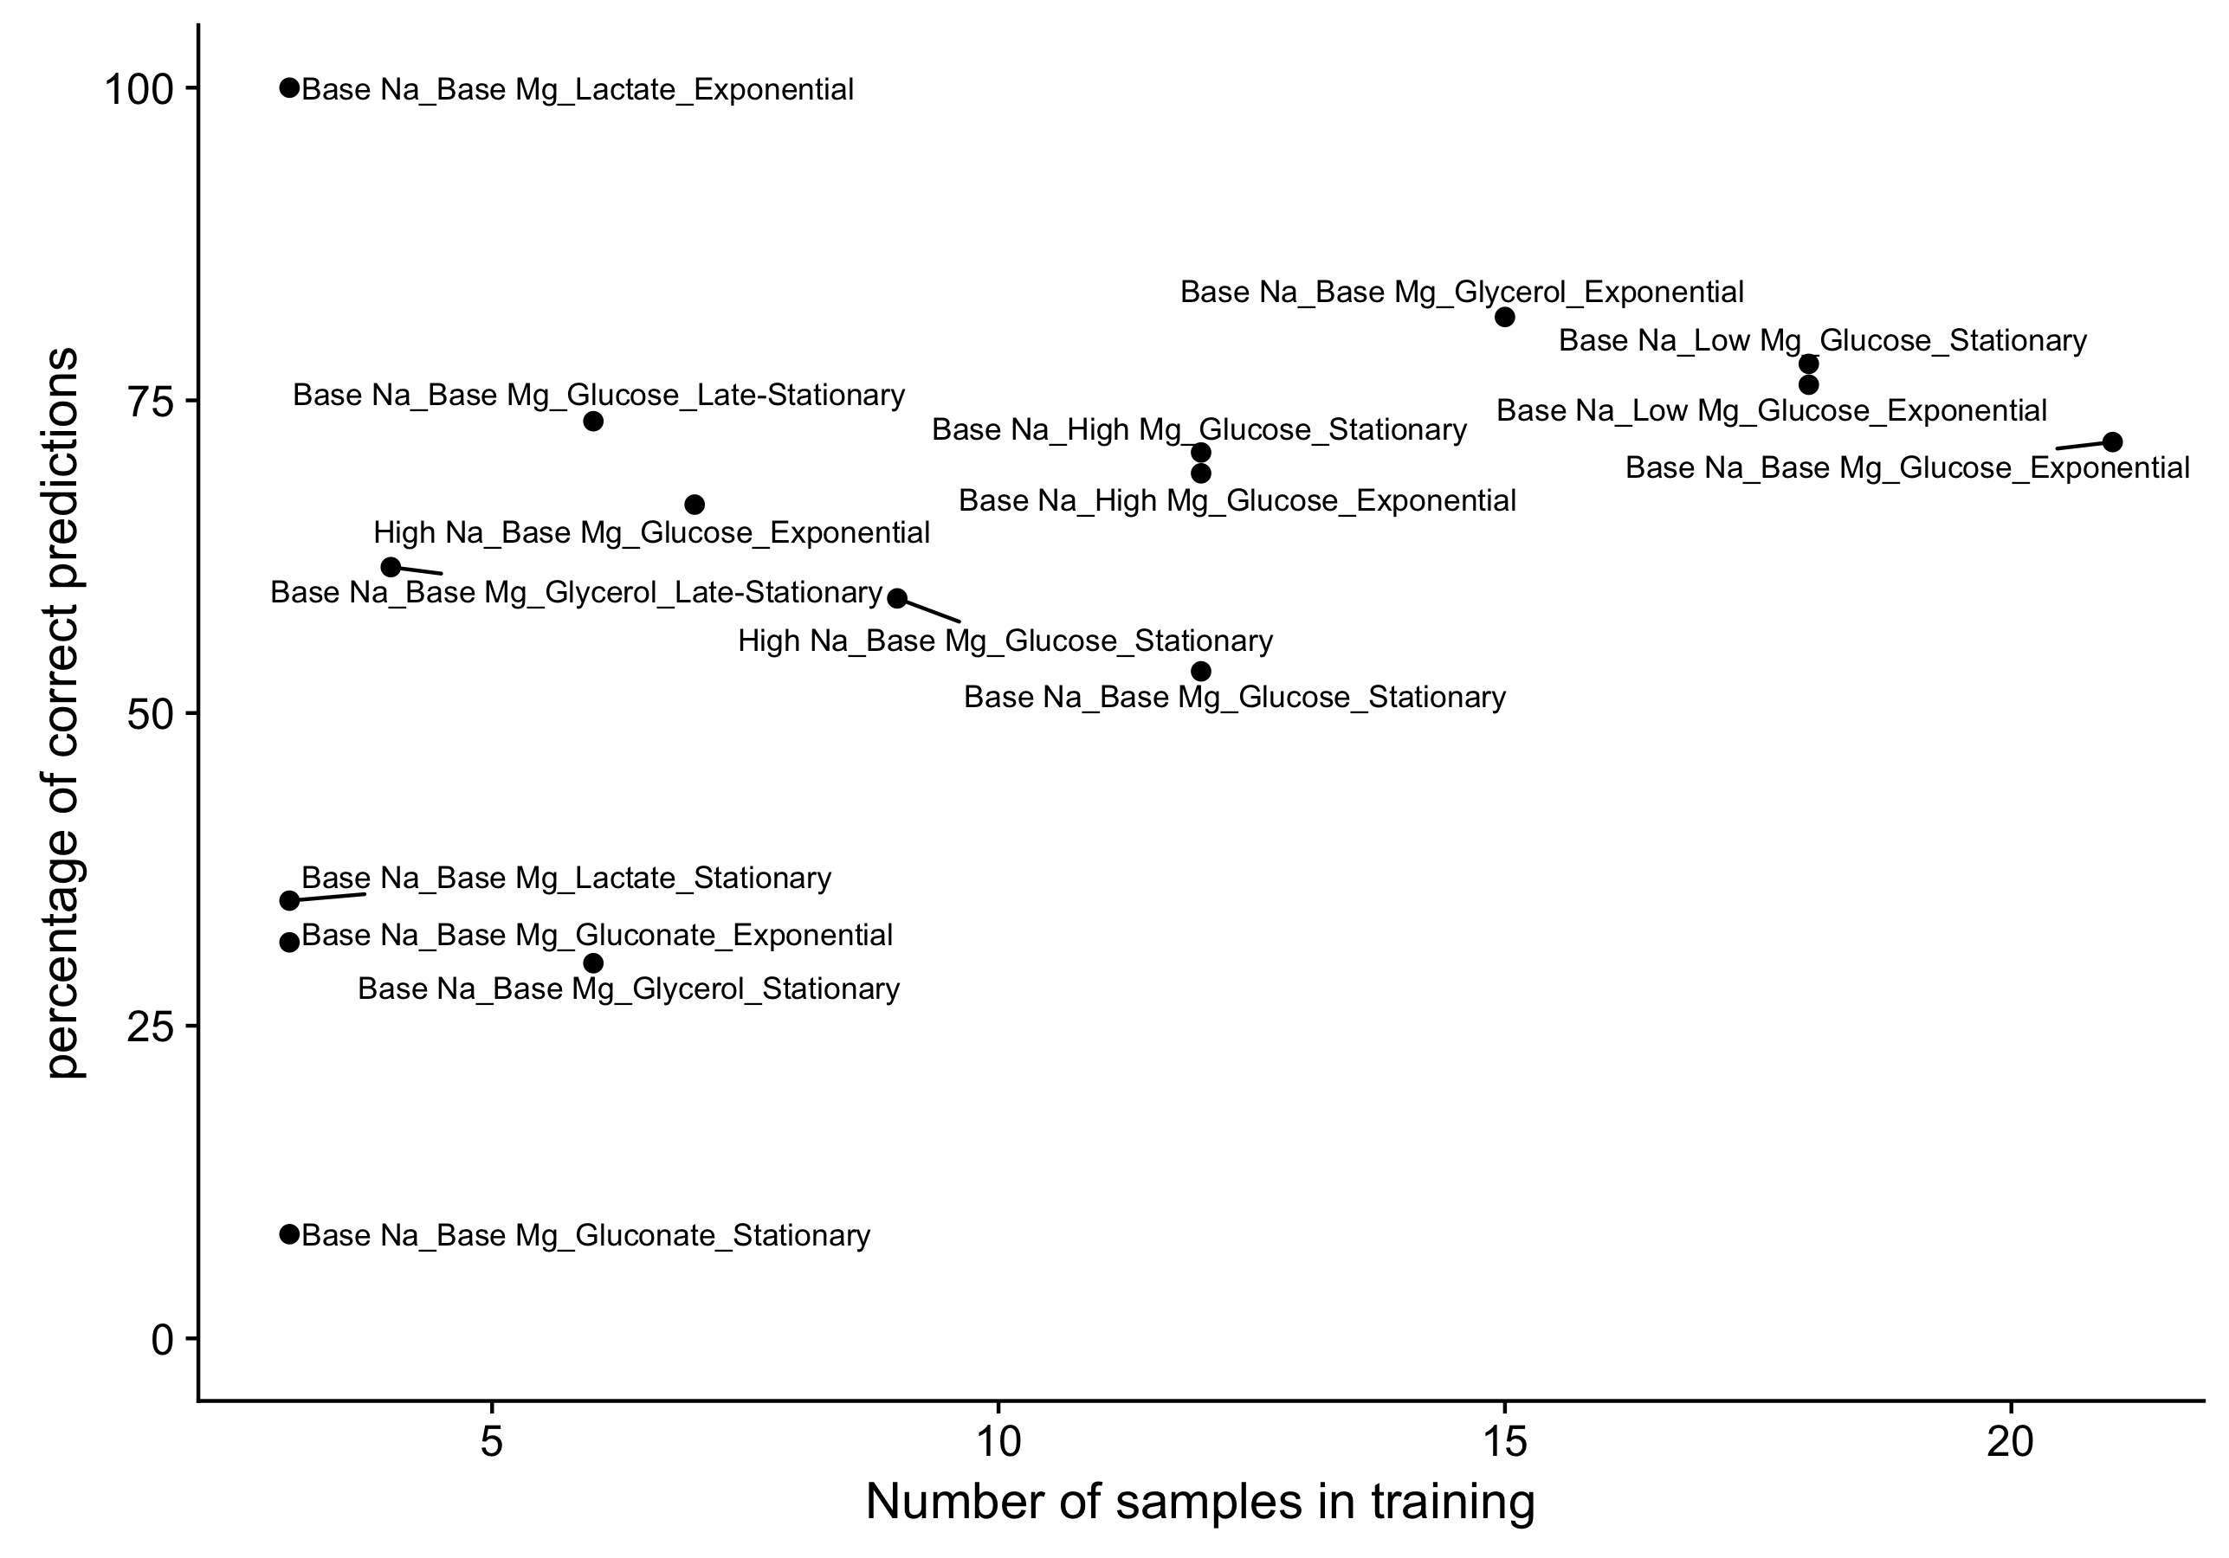
Predictions get better as we have more samples (mRNA data)

Slide 19
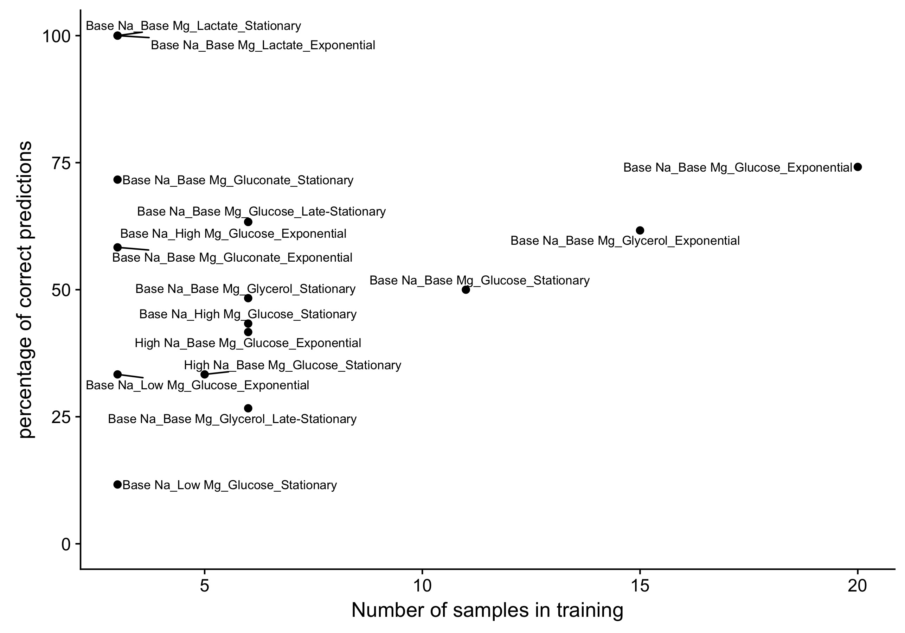
Predictions get better as we have more samples (protein data)

Slide 20
Joint prediction from mRNA and protein data performs better than prediction from either alone

Slide 21
Can we predict bacterial growth conditions from mRNA and protein abundances by machine learning?
Yes, and
it does not depend much on model, it depends on data type, and number of samples

Slide 22
Predictability decreases between phases

Slide 23
Individual Predictions

Slide 24
Predictability for individual conditions vary. Results are consistent with clustering of samples

Slide 25
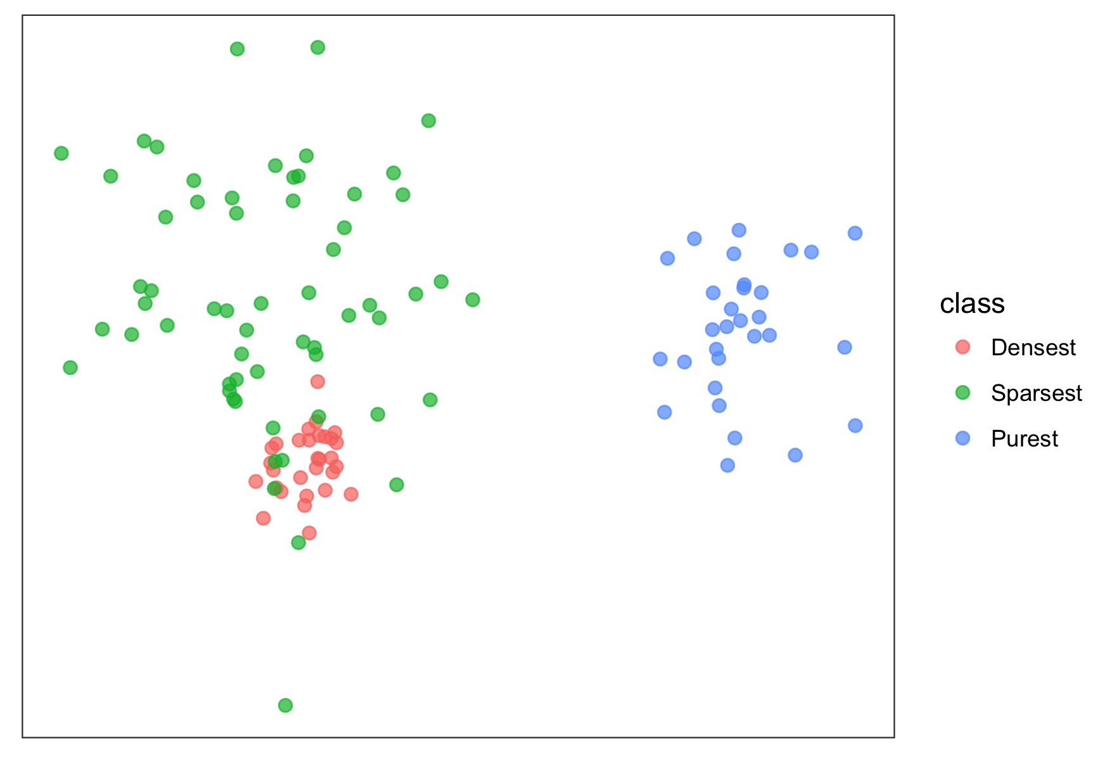
The cophenetic distance measures purity (Example data)

Slide 26
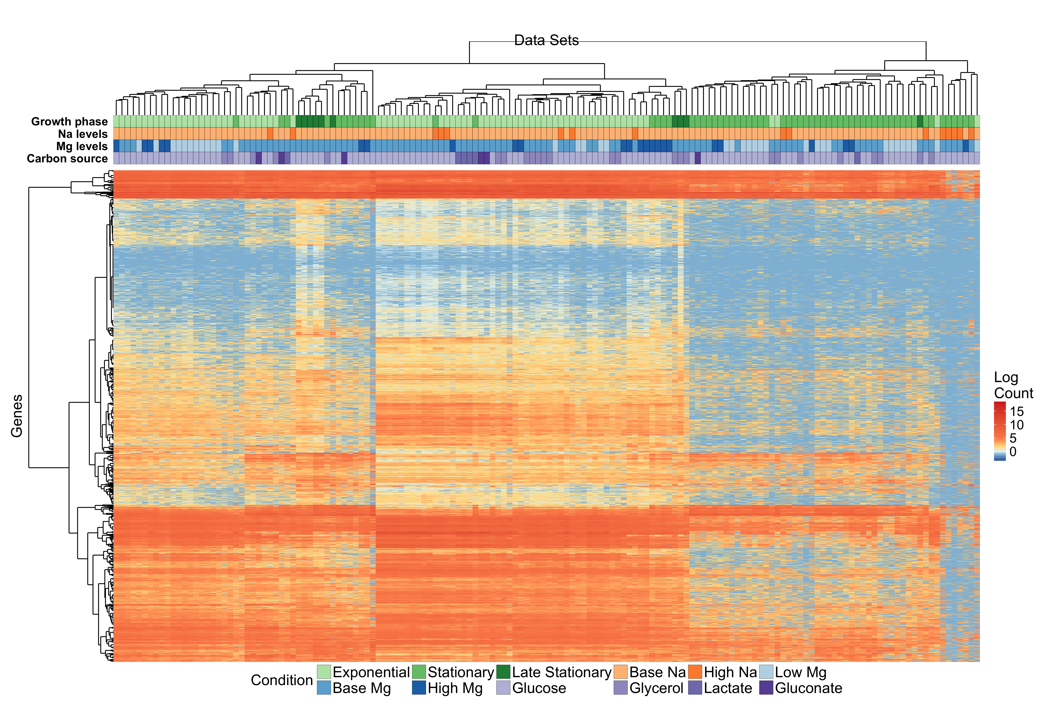
Clustering of mRNA data that minimize cophenetic distance

Slide 27
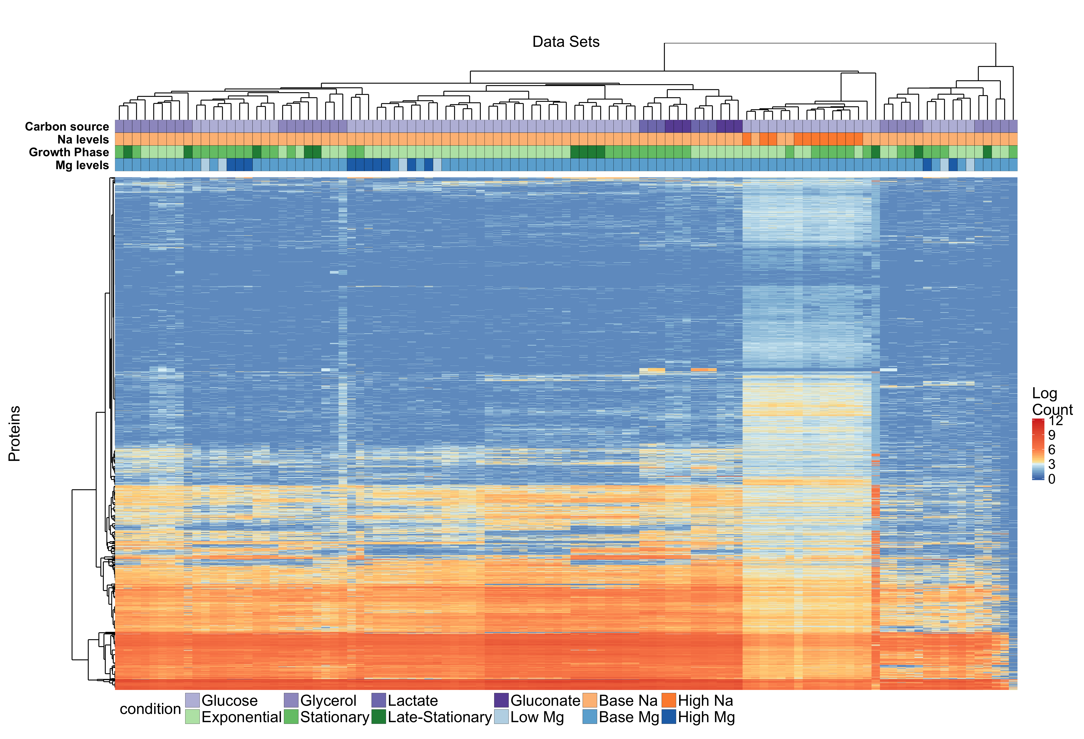
Clustering of protein data that minimize cophenetic distance
Notes:
dendogram

Slide 28
Z- scores tell the same story
mRNA | Protein
Growth | Carbon
Na | Na
Mg | Growth
Carbon | Mg

Slide 29
Out of House Data
Schmidt, Alexander, et al. "The quantitative and condition-dependent Escherichia coli proteome." Nature biotechnology 34.1 (2016): 104-110.

Slide 30
5 triplet samples that match to our experiment
Glucose (Exponential phase, no osmotic stress)
Glycerol (Exponential phase, no osmotic stress)
50 mm Na (Exponential phase) *In our experiment have Na levels of 5, 100, 200, 300 mm; where all except 5mm is labelled as high Na
Stationary phase (Glucose, no osmotic stress, 24 hours) *In our experiment 24 and 48 hours are labelled as stationary
Late-stationary phase (Glucose, no osmotic stress, 72 hours) *In our experiment 24 ,48 hours are labelled as stationary and 168, 336 hours are labeled as late-stationary

Slide 31
Fewer proteins were covered in the study, that results in two distinct approaches. 4196 vs 1722 Proteins
Add synthetic data for missing parts
Remove actual data

Slide 32
Add synthetic data for missing parts
SAMPLES
TRAINING DATA
PROTEIN ABOUNDANCES
TEST DATA

Slide 33
Add synthetic data for missing parts; predictions
Test |  | Predictions
 |  | Na level | Mg Level | Carbon source | Phase
Glucose |  | base Na | high Mg | Glucose | Exponential
Glycerol |  | base Na | high Mg | Glucose* | Exponential
Na 50 Stress |  | base Na* | high Mg | Glucose | Exponential
Stationary |  | base Na | base Mg | Glucose | Stationary*
Late stationary |  | base Na | base Mg | Glucose | Stationary*
Black indicates a correct prediction
Orange indicates a prediction in between
Red indicates a wrong prediction
“*” indicates a true not-base value
This approach have a bias toward conditions with more samples

Slide 34
Remove actual data from training
SAMPLES
TRAINING DATA
TEST DATA
PROTEIN ABOUNDANCES

Slide 35
Add synthetic data for missing parts; predictions
Test |  | Predictions
 |  | Na level | Mg Level | Carbon source | Phase
Glucose |  | base Na | base Mg | Gluconate | Exponential
Glycerol |  | base Na | base Mg | Gluconate* | Exponential
Na 50 Stress |  | High Na* | base Mg | Glucose | Exponential
Stationary |  | base Na | base Mg | Glucose | Stationary*
Late stationary |  | base Na | base Mg | Glucose | Stationary*
Black indicates a correct prediction
Orange indicates a prediction in between
Red indicates a wrong prediction
“*” indicates a true not-base value

Slide 36
What was the performance for our data
Predicted
X
True

Slide 37
Conclusion
We can predict bacterial growth conditions from mRNA and protein abundances by machine learning.
Learning model does not change much in predictive power.
Predictability decreases in stationary phase
Predictability for individual conditions are consistent with clustering of samples
We can make predictions with out of house data.

